Slide 1
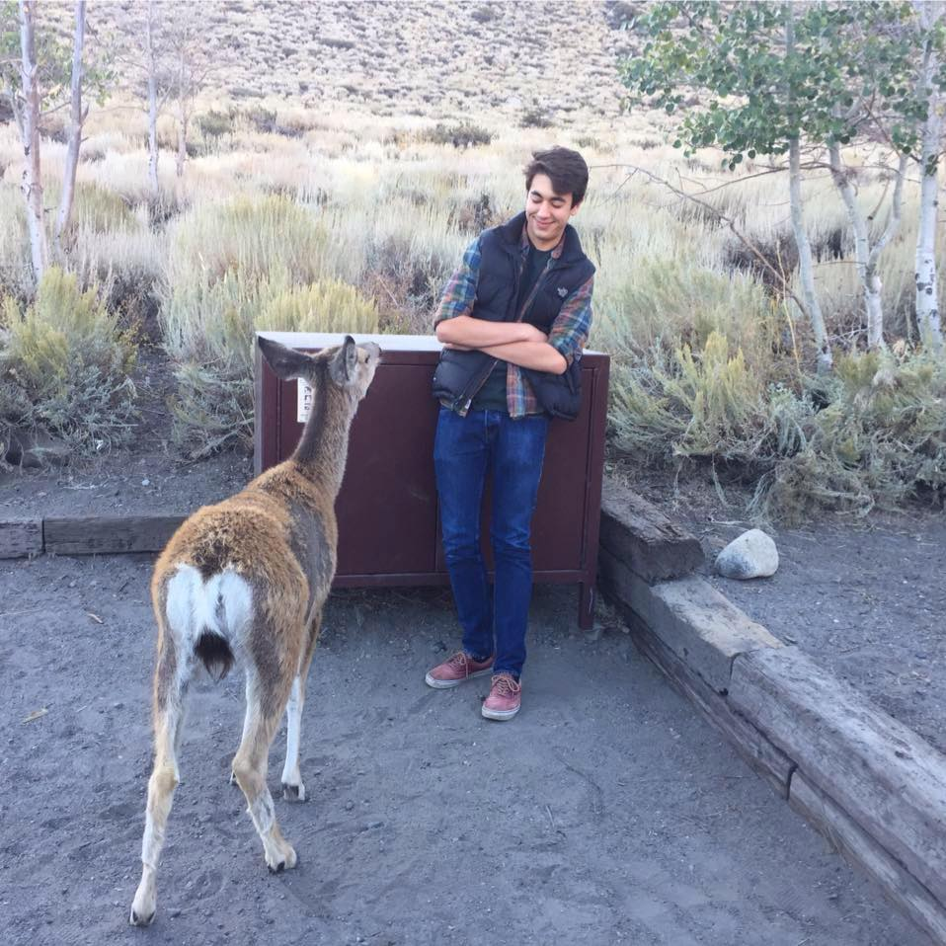
Christopher Motia Kelley Compass 1: T-175 Fall 2018
Career POSSIBILITIES AND Research project

Slide 2
Key Career Research Findings
Advertising planner
This Career possibility fits because it goes along well with my interest of working in teams as well as working with people. Another motivator for me is the rapid growth found in the industry primarily because the startup field caused by companies wanting to market to millennials . While I don’t have any work experience in the field I have had a moderate amount of exposure working with consulting and really enjoyed the researching clients. This desire to research and understand what people want is the primary thing that drives me towards this field.
Possible Majors: Marketing
Data Analyst
With an Emphasis on mathematics this career seems interesting to me based on its practical applications. While most people don’t typically think of a statistical field as “impactful”, analysts actual have a heavy impact on mitigating financial risk and saving companies money. Because of this impact becoming a Data Analyst is a major possibility for me.
Possible Majors: Information Systems, Marketing

Slide 3
Interests Overview
Managing People and teams
With my background in Scouting, Student government and recently ROTC I’ve had a lot of opportunities for leadership in my brief 19 years on conscious existence. Because of these groups I was able to organize and eagle scout project, lead a canoeing trip down the Colorado river, and organize a squad raid during a field training exercise. In each of these I found that delegation of obligations were extremely important and overtime I came to understand that these positions were something that compelled me to do my best as others were counting on me too.
Influencing Others
While many of my peers don’t have experience with mentoring others by the time they reach college my high school actually created a system in which older students were paired with younger students in order to help all parties better themselves and their communities. Because of this opportunity I found myself able to help guide younger students towards clubs and organizations that I’d seen help students in the past. Furthermore this interest allowed me to build lasting relationships with people I otherwise would not have met. Lastly this trait is important to me because it aligns with my value of leaving a positive impact on the world, something I believe mentoring does

Slide 4
V.I.P.S
Values
Curiosity
Fairness
Growth
Knowledge
Security
Personality
Guardian Supervisor ESTJ
Being a Guardian I’ve found that a lot of things that I do in life are done in order to help and impress other people. This applies to my career choice because most jobs in Finance require working with other people and building favorable connections with them. Another fact about being a Guardian is that I enjoying doing things in order and because of the step based nature of working in Finance it is satisfying to Guardians as it gives them the ability to “Check off boxes”.
Themes
Optimism, Passion, Charisma
Skills and STAR Story→

Slide 5
V.I.P.S Continued
Skills
Persuasion, Charisma, and Optimism
One real culmination of everything I’ve learned for my experience discovering my V.I.P.S comes from my successful recovery of my Platoons Guidon
A Guidon is a flag that serves as a source of pride for all military units even at the smallest level. And while it is important to show up to every event with it sometimes the people in possession of it don’t wake up on time. Especially for training events at 5:30 in the morning. It happened to be one of these cold Monday mornings in which my team leader and driver to these events was tasked with picking myself and two other cadets, one of which happened to be the guidon carrier who had happened to not have set an alarm.
We realized we would all be reprimanded for this lapse in judgement if we didn’t act quick and had to spring into action as to how to wake him up and retrieve our flag.
While some people are light enough sleepers to be awoken with a rock hitting their window, at that moment in time all attempts seemed of no use. This was until an Indiana university maintenance truck pulled down the street towards the residence hall we had been lobbing stones at. I waved them down in a way that in the moment must have seemed a tad odd, but nevertheless they pull over and asked what was wrong. I explained we needed to wake up our friend and asked if we could use the ladder on the back of their truck to knock on their window.
While I assume the army uniform I was wearing at the time helped him trust me a tad, I do think my personable skills really shined in the moment as I was able to instill a sense of trust and security in someone I had just met.

Slide 6
Major Possibilities
Accounting: Understanding and analyzing financial records concerning assets, liabilities, and how to operate a business.
Economic Consulting: Understand how to apply all levels of economics to solve problems in businesses.
Entrepreneurship: Learn the skills required to make a small business flourish in a variety scenarios.
Finance: Understand corporate and international finance subjects such as analyzing profitability and funding in preparation for a career in finance or investment banking.
Information Systems: Understand technologies role in the business world and management techniques designed to maximize efficiency with technology.
Management: Understand ways in which to organize and manage in different settings. On top of this the major also teaches essential skills to help with working in teams at work.
Marketing: Understand the process of how to create promote and develop products and services and make yours stand out above competition. On top of that marketing is also extremely helping in allowing you to better your personal brand and marketing yourself.
Professional Service: Help supply and support other businesses and learn how to make your products service stand out among the completion regardless of what industry it is in.
Supply Chain Management: Understand the components of a business and control the flow of resources within a company to maximize efficiency
Business Analytics: Understand how to process and respond to data in business and use this knowledge to complement knowledge in another field to enhance your decision making skills.
Digital and Social Media Business Applications: Hone your critical thinking ability to help understand a business presence on social media and how to improve it.
International Business: Understand how economic political and social world news impact multinational businesses.
Law, Ethics, and Decision Making: Understand and have a heightened awareness of ethnical dilemmas and dimensions within business decisions.
Sustainable Business: Understand a companies impact on the environment around it as well as how to incorporate sustainable business practices into a companies mission.
Technology Management: Learn how to compliment a companies major focus with technology management systems to maximize efficiency.
Notes:
https://kelley.iu.edu/programs/undergrad/academics/majors-minors-certificates.cshtml

Slide 7
Accounting
When many people think of accounting majors they typically assume that they all want to be accountants. But as with most assumptions this one is often wrong, as being an accounting major opens you up to career options and prepares you to understand even more of the financial world around you than your non-accounting co-workers. A great example of this is Corporate Lawyers. Many corporate law firms prefer undergraduate degrees in accounting because coupled with a law degree it gives the individual a massive leg up on understanding legislation around companies and legality of Business Decisions.
Flexibility is one of my major interests in this major as I am not completely positive on what I want to do in life but I know that no matter what I do having a background in accounting will help me in countless ways by not only helping me understand my personal finances but also those of companies.
While there are a lot of positives to accounting degrees in my personal opinion where I struggle with accounting is actual accounting work as while I did quite well in A100 I found it one of the most boring classes I have ever take as I just don’t think I clicked well with the subject matter. Nevertheless this negative is counteracted by the fact that If I majored in accounting there are so many other options that being an accountant.
This is in part due to the fact that the Kelley School of Business empowers me to diversify my studies and not only focus on accounting but also important fields like Business Analytics. On top of this the 5 year MBA program that Kelley offers also enables students to become CPA exam ready and enter the workforce with a qualification that most schools often leave students to fend for themselves over.
Career Options
Accountant: While currently I struggle to welcome being an accountant with open arms, it does align quite well with my values and interests as it provides a stable platform for growth and also allows you to contribute to a company in an important fashion.
Corporate Financial Lawyer: This profession seems extremely interesting to me on the grounds that the competitive aspects of it, teamwork, and security of positions align heavily with my values as a Guardian.

Slide 8
Information Systems
With a growing demand for technology in the workplace understanding how to help people interact with computers is becoming more and more essential for companies big and small. Because of this an Information Systems major is employable in almost every industry imaginable. Because of this flexibility I think this is a great fit for me.
On top of this the Kelley School of Business offers a wide variety of clubs and student groups to help students better understand industries. One of which being the investment management club which takes students from all majors and introduces them to topics and problems seen in the world of investment management.
Career Possibilities
Data Analyst: While the wide variety of possible industries to work in the actual daily nature of the job is not something that calls to me heavily. This is primarily because while the job is extremely important for companies I don’t consider myself a primarily quantitatively minded person which is primarily what this occupation consist of.
IT Consultant: As opposed to Data Analysis what makes this occupation unique is how it directly relates to the information systems mission statement of synergizing the relationship between the information systems in a company, humans and computers. Because of this liaison role I feel like this job aligns with my desire to work in teams and help other people learn

Slide 9
Marketing
Companies always need a public face and because of this marketing offers job security in a way that is extremely valuable to me. Another motivator for me with this major is the creativity aspects and how designs often go through collaboration with other team members in small settings where you can interact closely with your teammates.
With Kelley specifically in mind the marketing program has many opportunities for students to practice and hone their skills for the field such as the sales workshop, the consumer marketing academy and the marketing club. On top of that Kelley offers career services for this field using their extensive alumni network.
Careers
Market researcher: While I'm not personal a fan of the quantities analysis associated with market researching what is extremely interesting to me about is the pitching process of working with and impressing customers.
Advertising Planner: With an extremely rate of growth in the field caused by the social media boom being an advertising planner seems extremely appealing to me on the grounds that provides me room to develop my career but also express myself creatively and build relationships with clients from all different walks of life and industries.

